Slide 1

Channel Presenter Update on Product , Price , Promotion
February’2020

Slide 2
Outline
Price list
Model wise back margin
Trade campaign
Classified outlet modality
Channel focus models
SBC model wise incentive
Operator campaign
Outlet staging plan

Slide 3
Price List _Bar Phone
Model Name | RP (TK.) | CP (TK.)
B24 | 740.00 | 800.00
B12+ | 780.00 | 840.00
B65 | 790.00 | 850.00
B23 | 790.00 | 860.00
B60 | 800.00 | 860.00
B66 | 800.00 | 860.00
B21 | 800.00 | 870.00
B12i | 800.00 | 875.00
B17i | 810.00 | 880.00
BL98 | 820.00 | 890.00
BL97 | 845.00 | 910.00
BL95 | 880.00 | 950.00
D37 | 880.00 | 950.00
D38i | 900.00 | 970.00
BL60 | 915.00 | 990.00
BL90 | 920.00 | 999.00
D41 | 930.00 | 999.00
L42 | 970.00 | 1,050.00
BL110 | 970.00 | 1,060.00
D39 | 980.00 | 1,070.00
Model Name | RP (TK.) | CP (TK.)
D10 | 1,000.00 | 1,090.00
D38 | 1,000.00 | 1,090.00
L25i | 1,010.00 | 1,090.00
D40 | 1,040.00 | 1,120.00
D40i | 1,040.00 | 1,120.00
L40_SKD | 1,040.00 | 1,130.00
L55i | 1,050.00 | 1,130.00
L21 | 1,080.00 | 1,160.00
L130 | 1,070.00 | 1,160.00
L62 | 1,100.00 | 1,190.00
SL20 | 1,100.00 | 1,190.00
L23i | 1,100.00 | 1,199.00
L52 | 1,100.00 | 1,199.00
L250i | 1,160.00 | 1,250.00
D54+ | 1,170.00 | 1,270.00
D52+ | 1,190.00 | 1,290.00
L250 | 1,200.00 | 1,290.00
S40 | 1,190.00 | 1,290.00
L90 | 1,200.00 | 1,299.00
L110 | 1,220.00 | 1,320.00
Model Name | RP (TK.) | CP (TK.)
T130 | 1,250.00 | 1,350.00
D54j | 1,270.00 | 1,370.00
D52j | 1,290.00 | 1,390.00
L65j_SKD | 1,330.00 | 1,450.00
T140 | 1,370.00 | 1,490.00
L120 | 1,460.00 | 1,590.00

Slide 4
Price List _Bar Phone
Model Name | RP (TK.) | CP (TK.)
E90_SKD | 2,780.00 | 2,990.00
E95_SKD | 2,770.00 | 2,990.00
V48_SKD | 3,340.00 | 3,590.00
V44 | 3,560.00 | 3,840.00
V94_SKD | 3,620.00 | 3,890.00
V102_SKD | 3,610.00 | 3,890.00
V92 | 3,710.00 | 3,990.00
V99_SKD | 3,710.00 | 3,990.00
V105_SKD | 3,890.00 | 4,190.00
V97_SKD | 4,080.00 | 4,390.00
V141_SKD | 4,180.00 | 4,490.00
V98_SKD | 4,220.00 | 4,540.00
V128_SKD | 4,280.00 | 4,590.00
V75_SKD | 4,500.00 | 4,790.00
V96 | 4,520.00 | 4,899.00
V95 | 4,620.00 | 4,999.00
V78 | 4,970.00 | 5,290.00
i18_SKD | 5,010.00 | 5,390.00
V135 | 5,020.00 | 5,390.00
V142 | 5,100.00 | 5,490.00
Model Name | RP (TK.) | CP (TK.)
i15_SKD | 5,290.00 | 5,690.00
V140 | 5,280.00 | 5,690.00
V155 | 5,390.00 | 5,790.00
i68_SKD | 5,550.00 | 5,990.00
V145 | 5,560.00 | 5,990.00
V130 | 5,650.00 | 6,150.00
i65 | 5,750.00 | 6,190.00
R40_SKD | 5,750.00 | 6,190.00
V75m_2GB | 5,740.00 | 6,190.00
i72_SKD | 5,940.00 | 6,390.00
i74_SKD | 5,940.00 | 6,390.00
i95_SKD | 6,030.00 | 6,490.00
V150 | 6,090.00 | 6,590.00
i10+_SKD | 6,540.00 | 6,990.00
i97_SKD | 6,470.00 | 6,990.00
i60 | 7,075.00 | 7,575.00
Z12_SKD | 7,350.00 | 7,990.00
i75 | 7,910.00 | 8,490.00
i90 | 7,890.00 | 8,490.00
Z15_SKD | 7,890.00 | 8,490.00
Model Name | RP (TK.) | CP (TK.)
i70 | 8,050.00 | 8,790.00
i110_SKD | 8,340.00 | 8,990.00
Z20_SKD | 8,310.00 | 8,990.00
Z25_SKD | 8,310.00 | 8,990.00
i90_2GB | 9,100.00 | 9,790.00
i120 | 9,190.00 | 9,990.00
S5 | 10,330.00 | 10,990.00
S2 | 14,190.00 | 14,990.00
S10 | 17,790.00 | 18,990.00
S20 | 19,740.00 | 20,990.00
S25 | 20,740.00 | 21,990.00

Slide 5
Retail Offers _ Model wise back margin_ February’2020
Model | RP (TK.) | CP (TK.) | Upfront Margin | Retailer Incentive on Activation | Retail Lifting Commission | Total Retail Margin | Margin%
B12+ | 780 | 840 | 60 | - | 10 | 70 | 9%
B23 | 790 | 860 | 70 | 10 | 30 | 110 | 14%
B65 | 790 | 850 | 60 | - | 10 | 70 | 9%
B12i | 800 | 875 | 75 | 10 | - | 85 | 11%
B21 | 800 | 870 | 70 | 10 | - | 80 | 10%
B60 | 800 | 860 | 60 | - | 10 | 70 | 9%
B66 | 800 | 860 | 60 | 10 | - | 70 | 9%
B17i | 810 | 880 | 70 | 10 | - | 80 | 10%
BL98 | 820 | 890 | 70 | 10 | - | 80 | 10%
BL97 | 845 | 910 | 65 | - | 10 | 75 | 9%
BL95 | 880 | 950 | 70 | 20 | 40 | 130 | 15%
D37 | 880 | 950 | 70 | - | 10 | 80 | 9%
D38i | 900 | 970 | 70 | 10 | - | 80 | 9%
D41 | 930 | 999 | 69 | - | 10 | 79 | 8%
BL110 | 970 | 1060 | 90 | 10 | - | 100 | 10%
L42 | 970 | 1050 | 80 | 10 |  | 90 | 9%
D39 | 980 | 1070 | 90 | 10 | - | 100 | 10%
D10 | 1000 | 1090 | 90 | - | - | 90 | 9%
D38 | 1000 | 1090 | 90 | 10 | - | 100 | 10%
L25i | 1010 | 1090 | 80 | 20 | - | 100 | 10%
D40 | 1040 | 1120 | 80 | 20 | - | 100 | 10%
D40_SKD | 1040 | 1120 | 80 | 20 | - | 100 | 10%
D40i | 1040 | 1120 | 80 | 20 | - | 100 | 10%
L40 | 1040 | 1130 | 90 | 20 | - | 110 | 11%
L40_SKD | 1040 | 1130 | 90 | 20 | - | 110 | 11%
L55i | 1050 | 1130 | 80 | - | 15 | 95 | 9%
L21 | 1080 | 1160 | 80 | 10 | - | 90 | 8%
L23i | 1100 | 1199 | 99 | - | 120 | 219 | 20%
L52 | 1100 | 1199 | 99 | 20 | - | 119 | 11%
L62 | 1100 | 1190 | 90 | 10 | - | 100 | 9%

Slide 6
Retail Offers _ Model wise back margin_ February’2020
Model | RP (TK.) | CP (TK.) | Upfront Margin | Retailer Incentive on Activation | Retail Lifting Commission | Total Retail Margin | Margin%
SL20 | 1100 | 1190 | 90 | 10 | - | 100 | 9%
SL20_SKD | 1100 | 1190 | 90 | 10 | - | 100 | 9%
L250i | 1160 | 1250 | 90 | 20 | - | 110 | 9%
D54+ | 1170 | 1270 | 100 | - | 10 | 110 | 9%
D54+_SKD | 1170 | 1270 | 100 | - | 10 | 110 | 9%
D52+ | 1190 | 1290 | 100 | - | 10 | 110 | 9%
S40 | 1190 | 1290 | 100 | 10 |  | 110 | 9%
L250 | 1200 | 1290 | 90 | - | 20 | 110 | 9%
L90 | 1200 | 1299 | 99 | 20 | - | 119 | 10%
L110 | 1220 | 1320 | 100 | 20 | - | 120 | 10%
T130 | 1250 | 1350 | 100 | 15 | - | 115 | 9%
D54j | 1270 | 1370 | 100 | 10 | 83 | 193 | 15%
D52j | 1290 | 1390 | 100 | 10 | 103 | 213 | 17%
L65j_SKD | 1330 | 1450 | 120 | 20 | 103 | 243 | 18%
L65j | 1330 | 1450 | 120 | 20 | 103 | 243 | 18%
T140 | 1370 | 1490 | 120 | 20 | - | 140 | 10%
L120 | 1460 | 1590 | 130 | 20 | 100 | 250 | 17%
V44 | 3560 | 3840 | 280 | 35 | 400 | 715 | 20%
V102_SKD | 3610 | 3890 | 280 | 50 | - | 330 | 9%
V92 | 3710 | 3990 | 280 | 40 | 200 | 520 | 14%
V99_SKD | 3710 | 3990 | 280 | 50 | - | 330 | 9%
V105_SKD | 3890 | 4190 | 300 | 60 | - | 360 | 9%
V97 | 4080 | 4390 | 310 | 70 | 200 | 580 | 14%
V97_SKD | 4080 | 4390 | 310 | 70 | 200 | 580 | 14%
V141_SKD | 4180 | 4490 | 310 | - | 80 | 390 | 9%
V98 | 4220 | 4540 | 320 | 50 | - | 370 | 9%
V98_SKD | 4220 | 4540 | 320 | 50 | - | 370 | 9%
V128 | 4280 | 4590 | 310 | - | 80 | 390 | 9%
V128_SKD | 4280 | 4590 | 310 | - | 380 | 690 | 16%
V75_SKD | 4500 | 4790 | 290 | 100 | - | 390 | 9%

Slide 7
Retail Offers _ Model wise back margin_ February’2020
Model | RP (TK.) | CP (TK.) | Upfront Margin | Retailer Incentive on Activation | Retail Lifting Commission | Total Retail Margin | Margin%
V75 | 4500 | 4790 | 290 | 100 | - | 390 | 9%
V96 | 4520 | 4899 | 379 | 50 | - | 429 | 9%
V95 | 4620 | 4999 | 379 | 75 | - | 454 | 10%
V78 | 4970 | 5290 | 320 | 130 | - | 450 | 9%
i18 | 5010 | 5390 | 380 | - | 70 | 450 | 9%
i18_SKD | 5010 | 5390 | 380 | - | 70 | 450 | 9%
V135 | 5020 | 5390 | 370 | 100 | 400 | 870 | 17%
V142 | 5100 | 5490 | 390 | 25 | 70 | 485 | 10%
V140 | 5280 | 5690 | 410 | 100 | 200 | 710 | 13%
i15 | 5290 | 5690 | 400 | 80 | - | 480 | 9%
i15_SKD | 5290 | 5690 | 400 | 80 | - | 480 | 9%
V155 | 5390 | 5790 | 400 | 120 | 200 | 720 | 13%
i68_SKD | 5550 | 5990 | 440 | 60 | - | 500 | 9%
V145 | 5560 | 5990 | 430 | 100 | 200 | 730 | 13%
V130 | 5650 | 6150 | 500 | 75 | - | 575 | 10%
V75m | 5740 | 6190 | 450 | 75 | - | 525 | 9%
V75m_2GB | 5740 | 6190 | 450 | - | 150 | 600 | 10%
R40 | 5750 | 6190 | 440 | - | 80 | 520 | 9%
R40_SKD | 5750 | 6190 | 440 | - | 80 | 520 | 9%
i72_SKD | 5940 | 6390 | 450 | - | 90 | 540 | 9%
i74_SKD | 5940 | 6390 | 450 | 90 | - | 540 | 9%
V150 | 6090 | 6590 | 500 | 100 | - | 600 | 10%
i60 | 7075 | 7575 | 500 | 145 | - | 645 | 9%
i90 | 7890 | 8490 | 600 | - | 140 | 740 | 9%
i75 | 7910 | 8490 | 580 | 100 | 1,000 | 1,680 | 21%
i70 | 8050 | 8790 | 740 | 75 | - | 815 | 10%
i90_2GB | 9100 | 9790 | 690 | 125 | - | 815 | 9%
i120 | 9190 | 9990 | 800 | 170 | 1,000 | 1,970 | 21%
S5Helio | 10330 | 10990 | 660 | - | 500 | 1,160 | 11%
S10Helio | 17790 | 18990 | 1200 | 300 | - | 1,500 | 8%

Slide 8
Retail Incentive : Symphony Twenty-20 Offer
Model | Retailer lifting incentive /pcs
V94 | 600
V48 | 600
E90 | 450
E95 | 450
i110 | 2,000

Slide 9
Channel Focus Model _February’2020
Model | RP (BDT) | CP (BDT)
Will be communicated soon

Slide 10
Retail Offers _ CO B.M. Modality (February’2020)
EO _ Back Margin Modality
SIS _ Back Margin Modality
RT Type | Secondary achievement category | Back Margin
EO | >= 20 Lac | 2.00%
 | >= 15 Lac ~ < 20 Lac | 1.80%
 | >= 10 Lac ~ < 15 Lac | 1.70%
 | >= 5 Lac ~ < 10 Lac | 1.50%
RT Type | Secondary achievement category | Back Margin
SIS | >= 10 Lac | 1.00%
 | >= 5 Lac ~ < 10 Lac | 0.70%
 | >= 3 Lac ~ < 5 Lac | 0.60%
 | >= 1 Lac - < 3 Lac | 0.50%
* Retail have to achieve minimum 80% of given target & back margin will be disbursed according to achievement slab.
Model | RP | Model wise lifting incentive/unit
 |  | EO | SIS
Will be communicated soon
* Please see next slide for terms & condition of back margin eligibility.

Slide 11
Retail Offers _ CO B.M. Modality (February’2020)
RT Cat | Target | Back Margin Eligibility
EO | 625,000 | Minimum achievement 5 Lac and 80% of given target.
SIS | 350,000 | Minimum achievement 2.8 Lac and 80% of given target
SIS Emerging | 220,000 | Minimum achievement 1.76 Lac and 80% of given target.
SIS Economy | 220,000 | Minimum achievement 1.76 Lac and 80% of given target.
Remarks
Focus model incentive:
To ensure focus model back margin EO have to achieve 80% of individual model wise given target & SIS outlets have to achieve 80% of value target & 80% of individual model wise target accordingly.
To ensure focus model back margin EO & SIS have to lift minimum 1 pcs of any 3 models out of 6.
Emerging retails are considered for development phase. If retail will achieve minimum sales of respective category (EO: 5 Lac, SIS- 3 Lac, SIS e- 2 Lac) consecutively 3 months, can upgrade their rank.
Existing category cant be changed before April‘20. After finishing Q1‘20 retail wise performance will evaluate again & finalize further action plan.
Target setting modality can be changed considering business necessity, market trend, festival impact, seasonality etc. in upcoming month.

Slide 12
FSM Offers _ SBC Focus Models February’20
HFM Model | CP (BDT) | SBC Incentive/Unit
Will be communicated soon

Slide 13
Operator Campaign

Slide 14
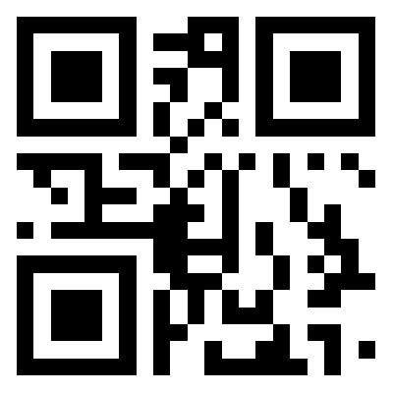
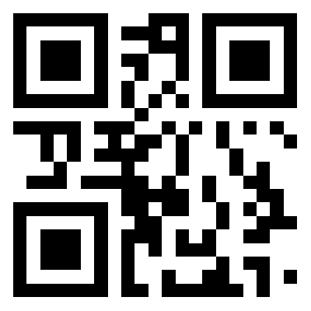
Bundle offer of Grameenphone 16 models
Handset Bundle Offer Chart(4G):
Model | Free (Unconditional Bonus) |  | (Conditional Bundle)
 | Data | Obtain process SMS or USSD | Details | Number of bundle pack purchase | Obtain process
Symphony i65 | 4GB + 5MB free 4G data [7 days validity] | Restart the Device (After inserting the SIM) | 1GB Open Data @ BDT. 79 [7 days validity] | maximum 6 times in 3 months | Type WS4G and SMS to 25050 (Free of Charge) Or scan QR code to follow process to purchase offer
Symphony i72
Symphony i95
Symphony i97
Symphony Z12
Symphony Z15
Symphony Z20
Symphony Z25
Check Point: Type CHK WS4G and send to 25050 (free of charge)
Handset Bundle Offer Chart(3G):
Model | Free (Unconditional Bonus) |  | (Conditional Bundle)
 | Data | Obtain process SMS or USSD | Details | Number of bundle pack purchase | Obtain process
Symphony V102 | 2GB Open data [7 days validity] | Restart the Device (After inserting the SIM) | 1GB @ BDT. 79 [7 days validity] | maximum 6 times in 3 months | Type WS3G and SMS to 25050 (Free of Charge) or scan QR code to follow process to purchase offer
Symphony V99
Symphony V105
Symphony V141
Symphony i15
Symphony V140
Symphony i18
Symphony R40
Check Point: Type CHK WS3G and send to 25050 (free of charge)

Slide 15
Offer Generic Details:
Keywords are not case sensitive.
Offer is model specific.
All new and existing prepaid and postpaid products are eligible for the campaign
This offer is not applicable for Skitto customers
Tagging Valid for 2 months but if any customer tagged in on 59th days then he/she can avail for each offer maximum 6 times in next 3 months.
Customer will get a confirmation SMS for valid tagging after opt in
For valid tagging, customers need to wait for 24 hours
To use 4G, customer needs to have a 4G enabled SIM card and a 4G handset under 4G coverage area
If tagging is unsuccessful then customer needs to restart the smartphone and send tagging request again or need contact Grameenphone customer service hotline 121
After valid tagging, customers need to follow the aforementioned instructions for Opt in
Bonus balance check. Prepaid and postpaid customers can check bonus & purchased internet balance by dialing *121*1*2#.
Maximum waiting time to avail the free offer is 24 hours
After expiration (Volume or Validity) of every internet pack maximum Pay Go rate will be 5.825 Tk (inclusive VAT, SD &SC). Unused Data Volume will be carried forward if the customer purchases the same pack(XGB at Tk XX) within the active validity period.
All the terms and conditions of internet packs will also be applicable here
To Cancel your Internet Offer, dial *121*3041#
In case of inactive SIM Cards or new SIM, please activate the number and then insert the activated number in the newly purchased handset for valid tagging.
For multiple tagging by same user, first valid tagging will be considered, and campaign benefit will be applicable. After valid tagging, bundle should be maintained.
If a customer does not renew the offer within 28 days, he/she will be deactivated automatically. There will be no auto renewal feature.
Above mentioned plan is limited time promotional offer and will be applicable till further notice.
Only valid and eligible IMEI will enjoy the bundle offer
Bundle offer eligibility depends on the IMEI list shared by the Device vendor 3 days prior of Device sales from the touch point
GP is not responsible for any Device’s IMEI which were not shared with GP for offer configuration for that specific campaign.
The offer is only applicable for Device Vendor/Authorized Distributer verified handsets. If any dispute arises regarding the handset authenticity, Device Vendor/Authorized Distributer will be liable entity
Retailers of the device vendors will ensure that the device sold to the customer is legally imported and is eligible for the bundle offer
No complaints regarding tagging will be applicable after the closing of the campaign.

Slide 16
Handset Bundle Offer Chart:
ROBI & Airtel offer
Model | Free (Unconditional Bonus) | (Conditional Bundle)
 | Data | Details | Obtain process
E90_SKD | 2GB internet [7 days validity] 2 Gb for 2 Months Every month customer will get 1GB with 7 days validity | 1GB @ BDT. 79 [7 days validity] | Robi: *123*079# Airtel: *121*079#
V48_SKD
V94_SKD
V97_SKD
V98_SKD
V75_SKD
V128_SKD
V141_SKD
V142
I10+_SKD
Banglalink Offer
Model | Free (Unconditional Bonus) | (Conditional Bundle)
 | Data | Details | Obtain process
E90_SKD | 3GB internet 1GB per month for 3 months, each bonus validity 7 days | Upto 45GB Bonus | Dial *5000*581# for 3.5GB(2GB+1.5GB Bonus) @TK209 for 30days. or dial *5000*799# for 3GB(1.5GB+1.5GB Bonus) @TK99 for 7 days. Total 30 times in 3 months.
V48_SKD
V94_SKD
V97_SKD
V98_SKD
V75_SKD
V128_SKD
V141_SKD | 6GB internet 2GB per month for 3 months, each bonus validity 7 days
V142
I10+_SKD

Slide 17
Offer Generic Details Robi & Airtel):
All Existing & New Robi/Airtel Pre-paid Mass & SME (Except PCO & easy load) subscribers are eligible for this offer
After purchasing specific handset, customer will generate a successful charge voice call to any valid Mobile No to register for eligibility checking. The customer must have minimum balance in the main account to make a valid call.
Bonus will be disbursed within 72hrs from tagging
If any subscriber in-active for more than 180 days will get the offer after 24 Hrs from 1st tagging. To get the bonus subscriber have to make another call after 24 hrs from activation tagging with the handset
We will consider the Mobile no and IMEI upon first tagging
Multiple Mobile no & IMEI tagging will not be considered
To check internet: *8444*88# or *3#
Notes:
Unused bonus data will not carry forward
Package wise all other tariffs/benefits will remain unchanged.
Robi, Airtel & Symphony reserve the right to finalize the eligibility
Bonus packs can be used only in newly purchased Symphony smartphone.

Slide 18
Outlet Staging Plan

Slide 19
Outline
This plan will help to understand which POSM will be available at outlets during the month of February
According to this plan, old POSM to be removed and new POSM to be executed
Some POSM of running product/campaign will continue

Slide 20
Plan for Feb 2020
Model / Campaign | Distribution Week | Outlet No | Store Front |  |  |  |  | In Store |  |  |  |  | Experience Zone |  |  | Remarks
 |  |  | X Banner | Poster | Festoon | Shop screen | Bunting | Dangler | Sticker | Shelf Highlighter | Leaflet | Poster | Ceiling Banner | Table Top | Leaflet
Z15 | W3, May | 500 | S |  |  |  |  | S |  |  | S |  |  |  | S | Stay
i68 | W1, Oct | 1.6k |  |  | S |  |  |  |  |  | S |  |  |  | S | Stay
Z20 | W3, Nov | 1k | S |  |  |  |  |  |  |  | S |  | S |  | S | Stay
I18 Price Cut | W1, Dec | 3.5k |  |  |  | S |  |  | S |  |  |  |  |  |  | Stay
GP | W4, Dec | 2.5k |  |  |  |  |  |  |  |  | S |  |  |  | S | Stay
Z12 | W4, Dec | 1.7k | S |  |  |  |  | S |  |  | S |  |  |  | S | Stay
Z25 | W4, Dec | 1.7k | S |  |  |  |  |  |  |  | S |  | S |  | S | Stay
Price Cut | W4, Jan | 1.7k |  |  | S |  |  |  | S (GB) |  | S |  |  |  | S | Stay
New Model | W4, Feb | 1.7k | S |  |  | S |  | S |  |  | S |  | S |  |  | Upcoming

Slide 21
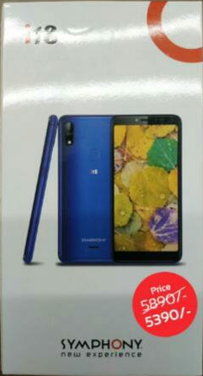
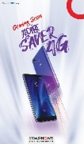
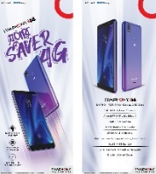
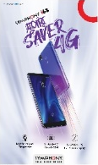


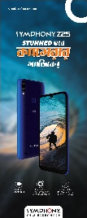
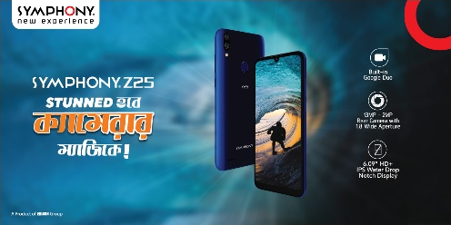
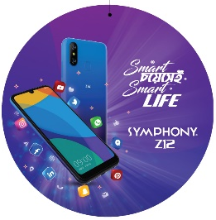
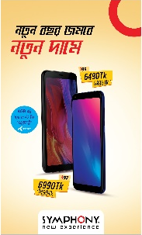

POSM to Continue
Campaign | POSM items | Creative
I18 Price Cut | Shop screen Sticker
Z12 | X-Banner Leaflet Dangler
I97 & i95 Price Cut | Festoon Leaflet Sticker
Campaign | POSM items | Creative
i68 | Leaflet Festoon
Z25 | X-Banner Ceiling Banner Leaflet
GP | Leaflet

Slide 22
February POSM (Upcoming)
Campaign | POSM items | Distribution Week | Creative
New Model | X-Banner Shop Screen Leaflet Dangler Ceiling Banner | W4, Feb | WIP

Slide 23







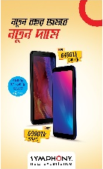

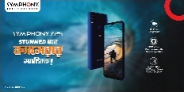



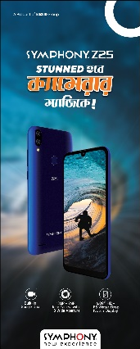
POSM Execution Guideline: EO
POSM | Models
X-Banner | Z12, Z25
Festoon | I68, Price Cut
Shopscreen | i18
C. Banner | Z25
Dangler | Z12
Leaflet | Z12, i68, Z25, GP, Price Cut
Table Top
1 Shopscreen in store front at the ceiling
10-12 Danglers at the ceiling
Leaflet to be placed on the Smart Table (100 pcs)
Max 2 X-banner and 2 Festoon at the most visible place of EO store front
1 Ceiling Banner on top of Smart Table from Ceiling. New Model Must display

Slide 24
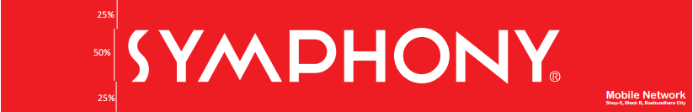
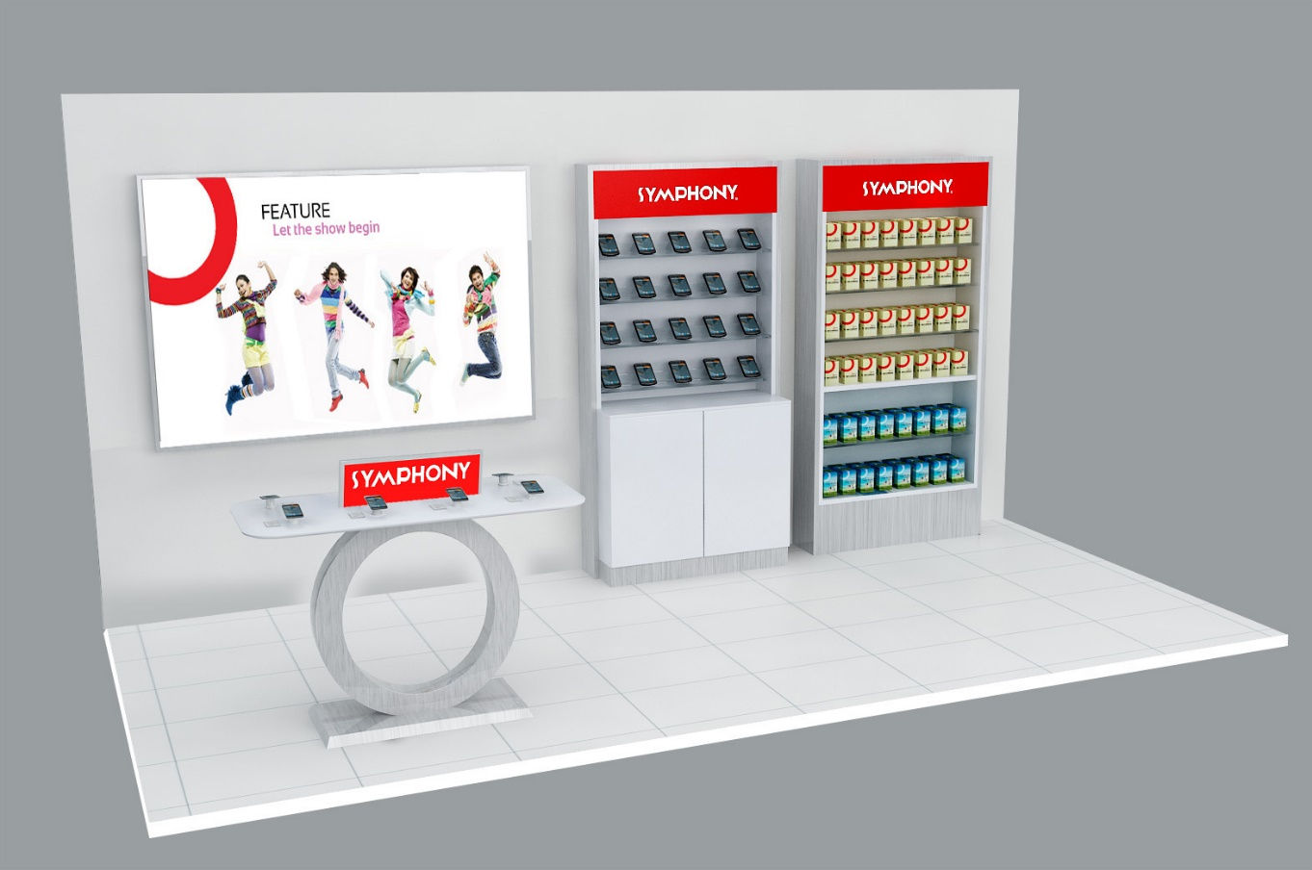
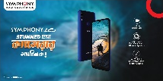


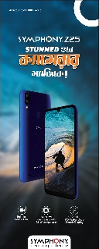
POSM Execution Guideline: SIS
POSM | Models
X-Banner | Z12, Z25
Festoon | I68, Price Cut
Shopscreen | i18
C. Banner | Z25
Dangler | Z12
Leaflet | Z12, i68, Z25, GP, Price Cut
Table Top
1 Shopscreen in store front from Ceiling
1 Ceiling Banner on top of Smart Table from Ceiling
6-8 Danglers at the ceiling
Leaflet to be placed on the Smart Table/ Counter (50 pcs)
Max 2 pcs festoon at store front

Slide 25
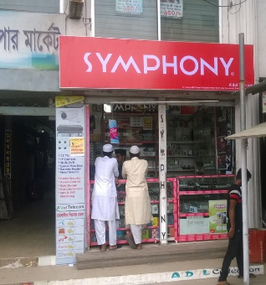
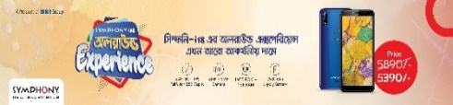


POSM Execution Guideline: GO
POSM | Models
Festoon | I68, Price Cut
Shopscreen | i18
C. Banner | Z25
Dangler | Z12
Leaflet | Z12, i68, GP, Z25, Price Cut
Poster/Sticker
1 Ceiling Banner & 4-6 Danglers at the ceiling
Leaflet to be given to retailer for consumer communication (30 pcs)
1 Festoon at the most visible place of GO store front
1 Poster of each type on the wall

Slide 26
Thank You

